Slide 1
Entitlement to Continuation Pay
(CP)
TC
6
OPNAV-ECPFRT-2.0
Catalog ID: OPNAV-ECPFRT-2.0 (Updated April 2023)

Slide 2

Agenda
Basic Finance
Consumer Protections
Planning for the Future
Saving and Investing
Summary and Resources
Entitlement to Continuation Pay Counselee Checklist Available

Slide 3
Basic Finance

Slide 4
Spending Plan
STEP 1 — Understand your current situation
  Track inflows and outflows
  Review past financial statements
STEP 2 — Know where your money should go
  Save and/or invest 10% – 15%*
  Transportation less than 15% – 20%*
  Limit housing to BAH or 25% or less*
STEP 3 — Create a plan
  Plan for new or different expenses
  Build an emergency fund
STEP 4 — Make adjustments
  Update with life changes
  Review frequently
STEP 1:
Understand your current
situation
STEP 4:
Make
adjustments
STEP 2:
Know where
your money
should go
4-STEP BUDGETING
PROCESS
  * Pretax income
STEP 3:
Create a plan
Spending Plan Worksheet Handout Available

Slide 5
Tax Fundamentals
Types of taxes
  Federal
  FICA
  State income taxes
Tax benefits for Service members
  BAH, BAS, and CZTE
  TSP and potential tax savings
Potential changes to your tax situation
  Review and adjust withholding on myPay
  IRS Tax Withholding Estimator

Slide 6
Tax Implications of Continuation Pay
Earned income
  Taxed at federal, state, and local levels
Tax planning
  Impact of one lump sum, two, or four installments
  Set aside funds to cover potential taxes
Combat Zone Tax Exclusion
  Review IRS Publication 3, The Armed Forces Tax Guide

Slide 7
Consumer Protections

Slide 8
Military Consumer Protections
Know your rights
Servicemembers Civil Relief Act (SCRA)
Military Lending Act (MLA)
Resources
  Military OneSource
  https://www.consumerfinance.gov/
  Installation legal office
Military Consumer Protection and Sources for Help for Military Consumers Handouts Available

Slide 9
Misleading Consumer Practices
Recognize scams
  Multilevel marketing / pyramid scheme
  Get rich quick
  Too good to be true
Protect yourself
  Research
  Comparison shop
  Sleep on it
Report a complaint
Sources of Help for Military Consumers Handout Available

Slide 10
Planning for the Future

Slide 11
The Four Components of BRS
Defined contribution
  Thrift Savings Plan with DoD automatic and matching contributions
Continuation Pay
  Mid-career incentive pay
Defined benefit
  Eligible for a pension after 20 years of service
Lump-sum option
  Choice on how to receive your pension at retirement
Military Retirement Handout Available

Slide 12
Continuation Pay Basics
One-time, mid-career bonus at 12-year mark
Paid in exchange for four years of additional service
Election is NOT automatic
In addition to other career incentives and
bonuses
A retention tool
Military Retirement and Continuation Pay Handouts Available

Slide 13
Continuation Pay Basics, Continued
Active duty or active reserve
BRS participants only
Based on pay entry base date (PEBD)
Elect between eight and 12 years of service
Agree to four years of additional service
Must elect before your 12th year of service
Paid on the first pay period following anniversary of 12 years of service

Slide 14
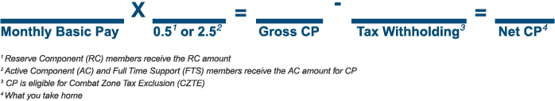
How Is CP Calculated?
CP rates for 2023
  Active duty – 2.5 times basic monthly pay
  Reserve – 0.5 times basic monthly pay
Pay-rate multiplier considerations
  Service-specific retention needs
  Specialty skills and hard-to-fill positions
  Similar to career field incentives and
  re-enlistment bonuses
Continuation Pay Handout Available

Slide 15
How Is CP Disbursed?
You can choose to receive a one-time, lump-sum payment or spread your payments to potentially save on taxes.
Two Equal Installments First installment is paid the first pay period after you start your 12th year of service, and the next installment is paid the following year
Four Equal Installments First installment is paid the first pay period after you start your 12th year of service and remainder in three equal annual installments
Pick your installment plan
One Lump Sum Installment
Must elect before your 12th year and is an irrevocable election
Paid the first pay period after you start your 12th year of service
Remember, CP
is subject to tax withholding!
Your payment choice may affect taxes owed.
Review the IRS Tax Withholding Estimator.

Slide 16
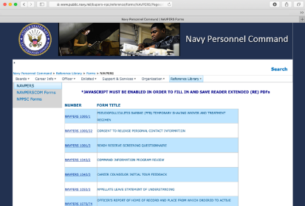
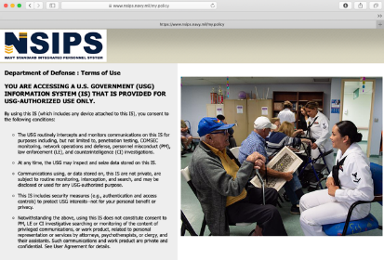
Applying for Continuation Pay
Complete NAVPERS 1070/613
with your command career counselor
Elect it through NSIPS

Slide 17
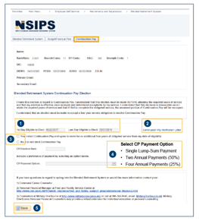
Applying Through NSIPS
Verify Continuation Pay eligibility in NSIPS
(Continuation Pay tab)
  First day to elect is 11 years six months after PEBD
  Election must be made before entering the
  first day of the 12th year of service
View / Print Continuation Pay Notification Letter
Indicate CP Election (Yes or No)
If elected, select payment option
  Single lump-sum payment
  Two annual payments (50%)
  Four annual payments (25%)
Save
Note: If a Sailor is unsure of the amount of Continuation Pay, they will be
paid at 12 YOS. It is recommended they contact their Command Career
Counselor or Command Financial Specialist.
1
2
3
4
5
Entitlement to Continuation Pay Handout Available

Slide 18
Financial Implications and Options
Failing to meet service obligations will require a repayment of a prorated amount.
What to do with your Continuation Pay
    Pay down debt
    Save for emergencies
    Invest for the future
    Make a major purchase
    Gift it
    Contribute to TSP

Slide 19
Saving and Investing

Slide 20
Evaluate Goals
Save 10% – 15% of pretax pay
Emergency fund
Invest for the long term
  Be patient
Dollar cost averaging
  Invest regular basis
  Invest continuously
TSP considerations
  Contributions from CP are not eligible for matching
  Elective deferral limit — $22,500
  Annual additions limit — $66,000 (CZTE)
  Plan contributions from basic pay to receive matching contributions
Basic Investing Handouts Available

Slide 21
Summary and Resources

Slide 22
Summary
Congratulations on reaching this important milestone!
Let’s recap what you learned to help in decision making as you approach eligibility for Continuation Pay:
  Basic Finance
  Consumer Protections
  Planning for the Future
  Saving and Investing

Slide 23


Resources
Checklist and Handouts
Financial Education and Support
  Command Financial Specialists (CFSs)
  Personal Financial Managers (PFMs)
  Fleet and Family Support Center (FFSC)
  Navy-Marine Corps Relief Society
  Military OneSource
Financial Literacy Mobile Apps
  MyNavy Financial Literacy
  Sen$e

Slide 24
Thank You!
The appearance of U.S. Department of Defense (DoD) visual information does not imply or constitute DoD endorsement.
Catalog ID: OPNAV-ECPFRT-2.0 (Updated April 2023)

